Slide 1
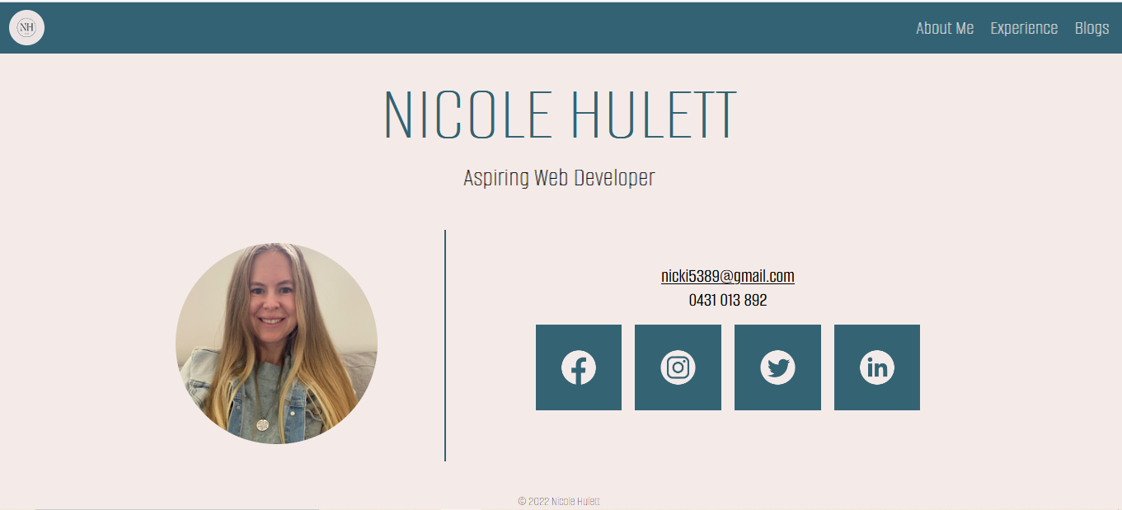
Nicole Hulett’s Slide Deck

Slide 2
Purpose:
To create a simple, easy to navigate portfolio website to showcase my HTML and CSS skills.
Features:
I have created a neat, plain design throughout the website, so as not to overwhelm any viewers.
Flexbox is utilized throughout to help layout each page.
All links open in a separate page and the navigation bar in the header makes it easier to navigate to the different pages.
Target Audience
- Prospective employers

Slide 3
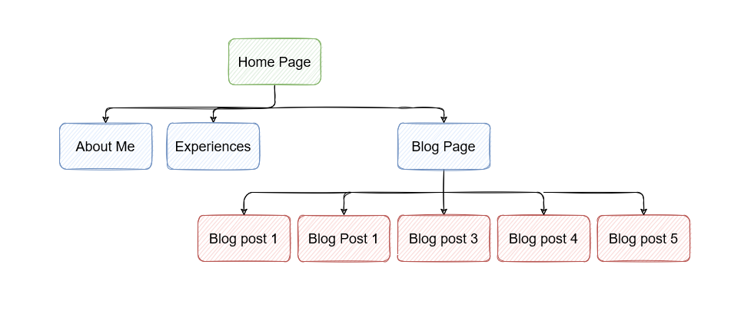
Site Map
The website consists of a landing page.
From this landing page, the user can access 3 other pages.
- 5 blog posts can also be accessed from the blog page.

Slide 4
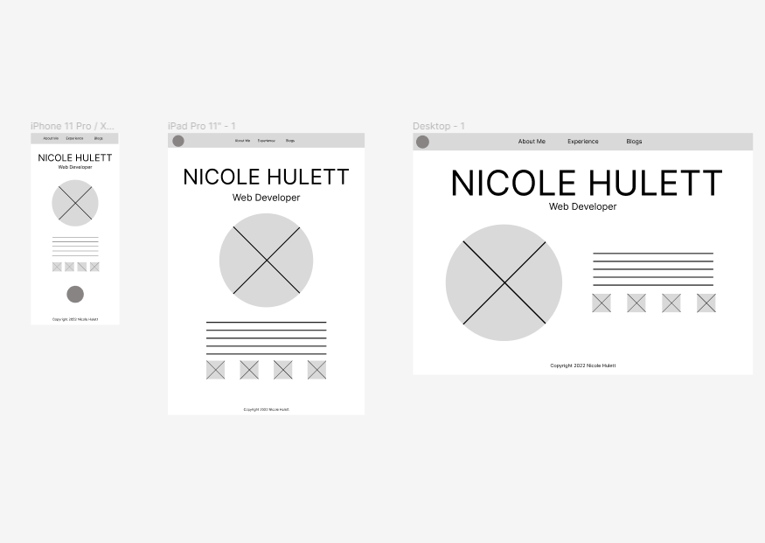
Wireframes for Landing page.
Mobile design didn’t include logo in the header.
- Flexbox will be utilized to layout all pages.
- A media query needed to be added to ensure the desktop version could be laid out.
- The 4 social icons are flex-items of a container.

Slide 5
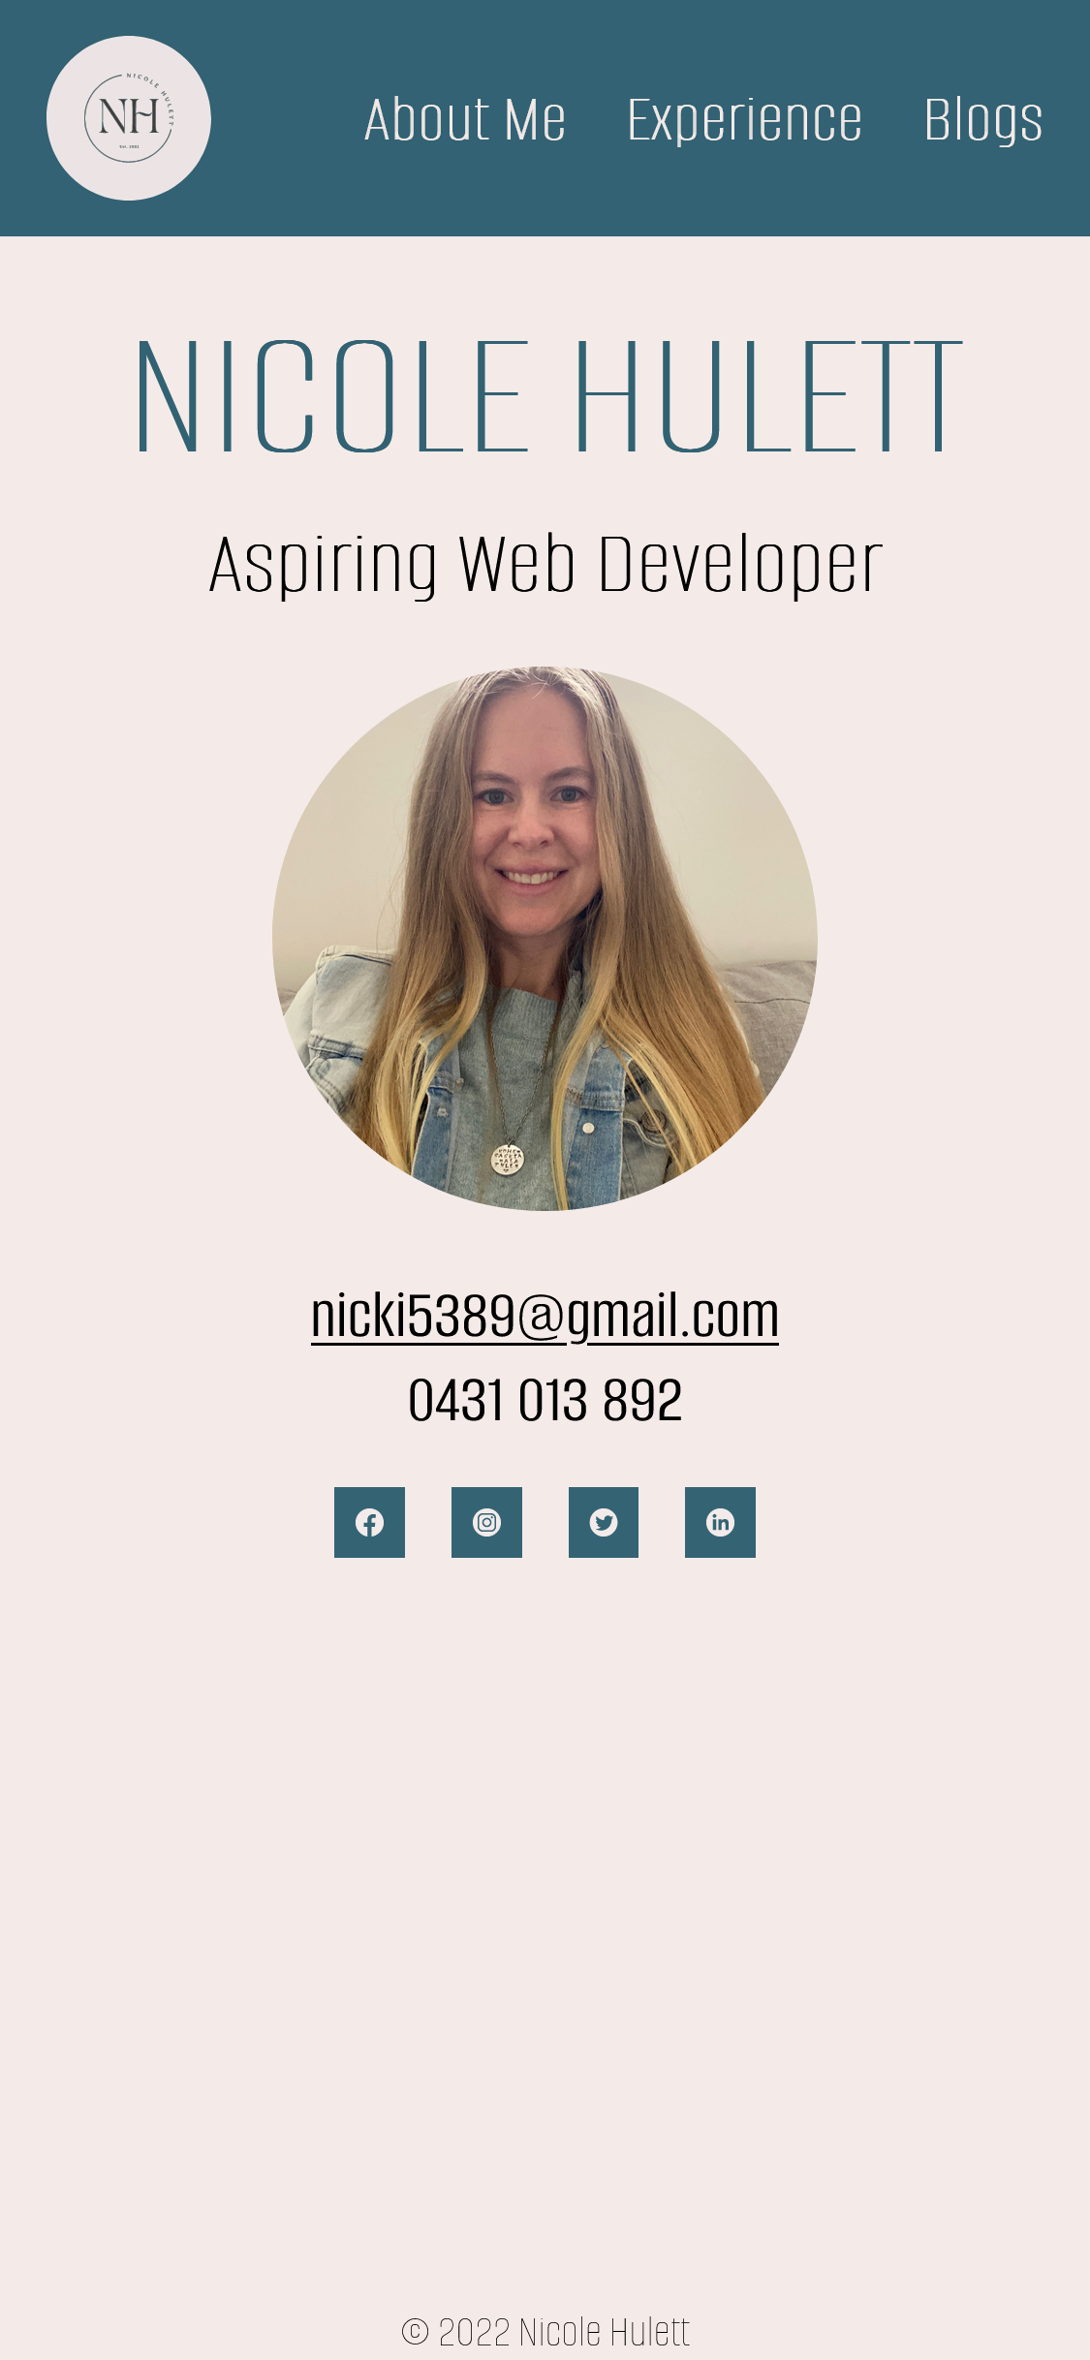
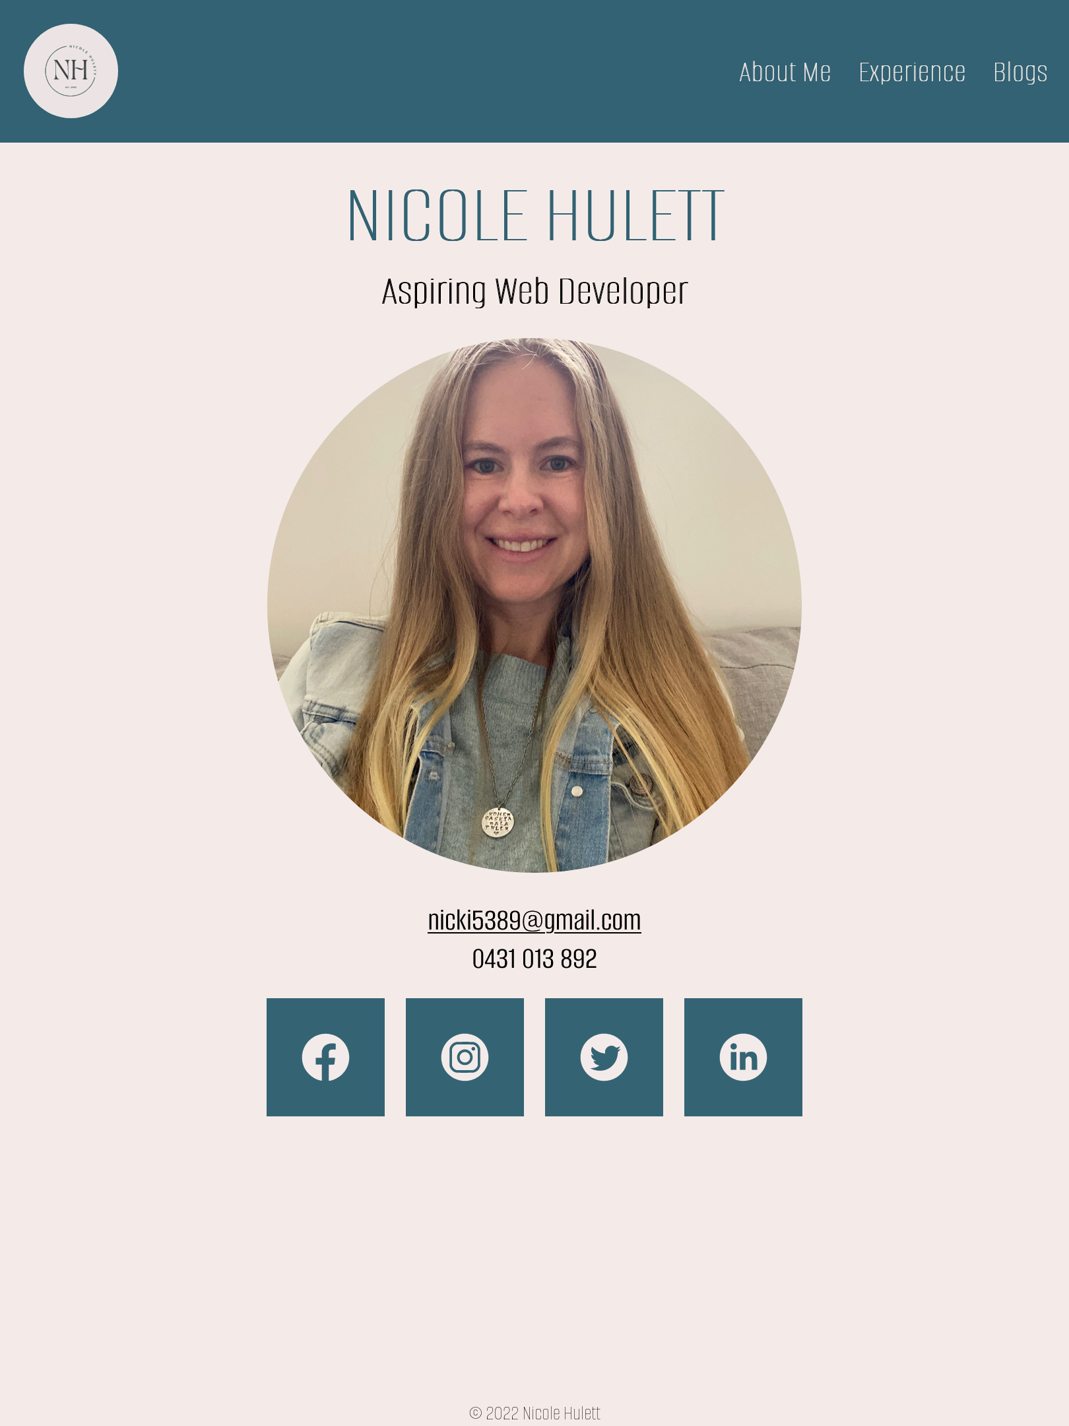

Main Page
Mobile-design changes the location of the logo/home page link compared to wireframe.
The header is the same design for all pages. The height of it is responsive to viewing device.
Layout changes for screen sizes over 920px. This allows user to see everything on one page without scrolling.
The profile pic decreases in size at 920px.
The email link opens in a new page. When hovered over it also changes the text and background colour so it appears like a button.
I created the icons in Canva to avoid the ethical issue of using other’s work.
There is a hover class on each of the social links so that they enlarge slightly when hovered over.

Slide 6
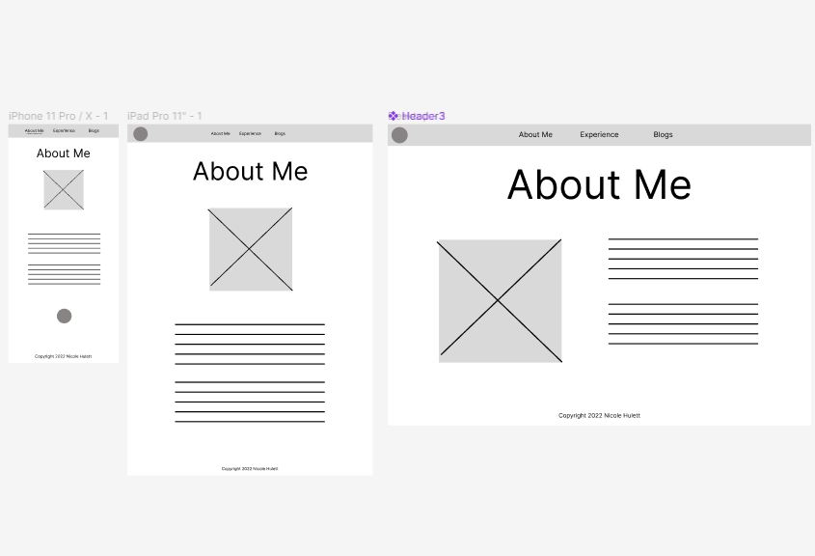
Wireframes for About Me page
The photo for this page was resized to 600px before being linked to this page to ensure faster loading speed.
- The photo also needs to be responsive so that it scales according to viewport.

Slide 7
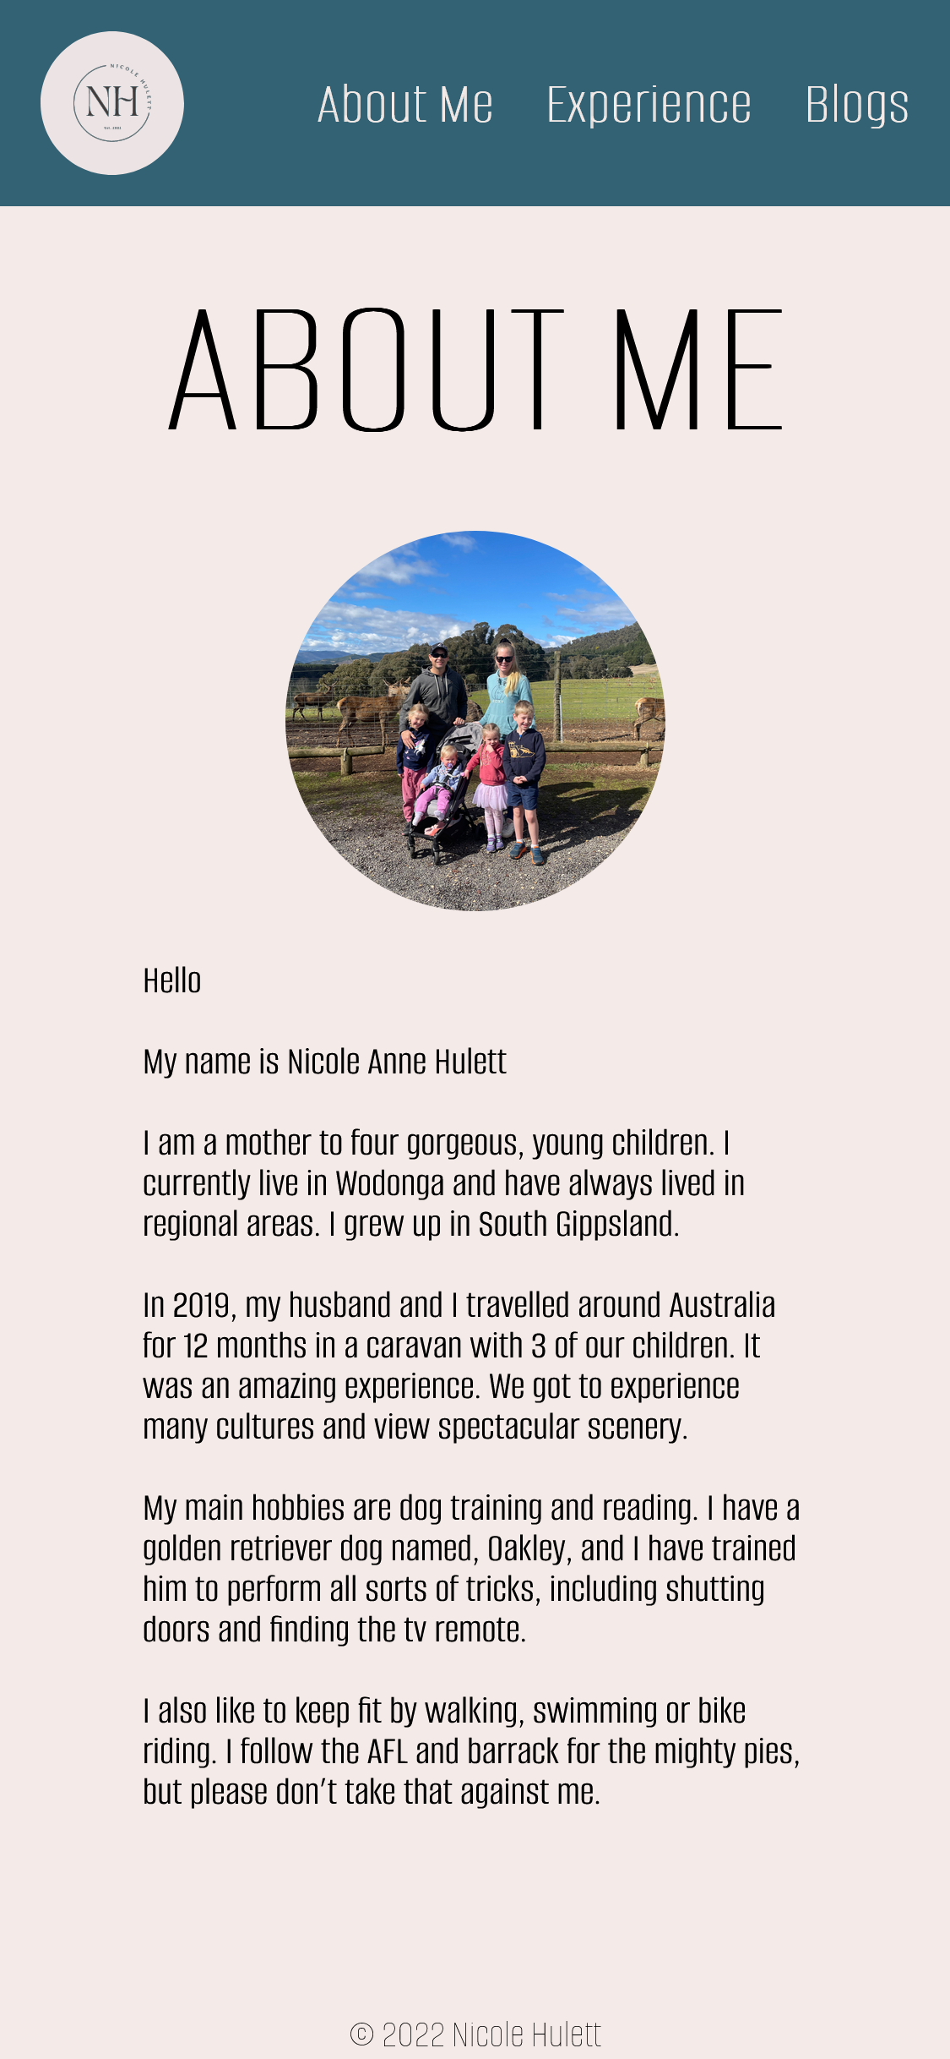
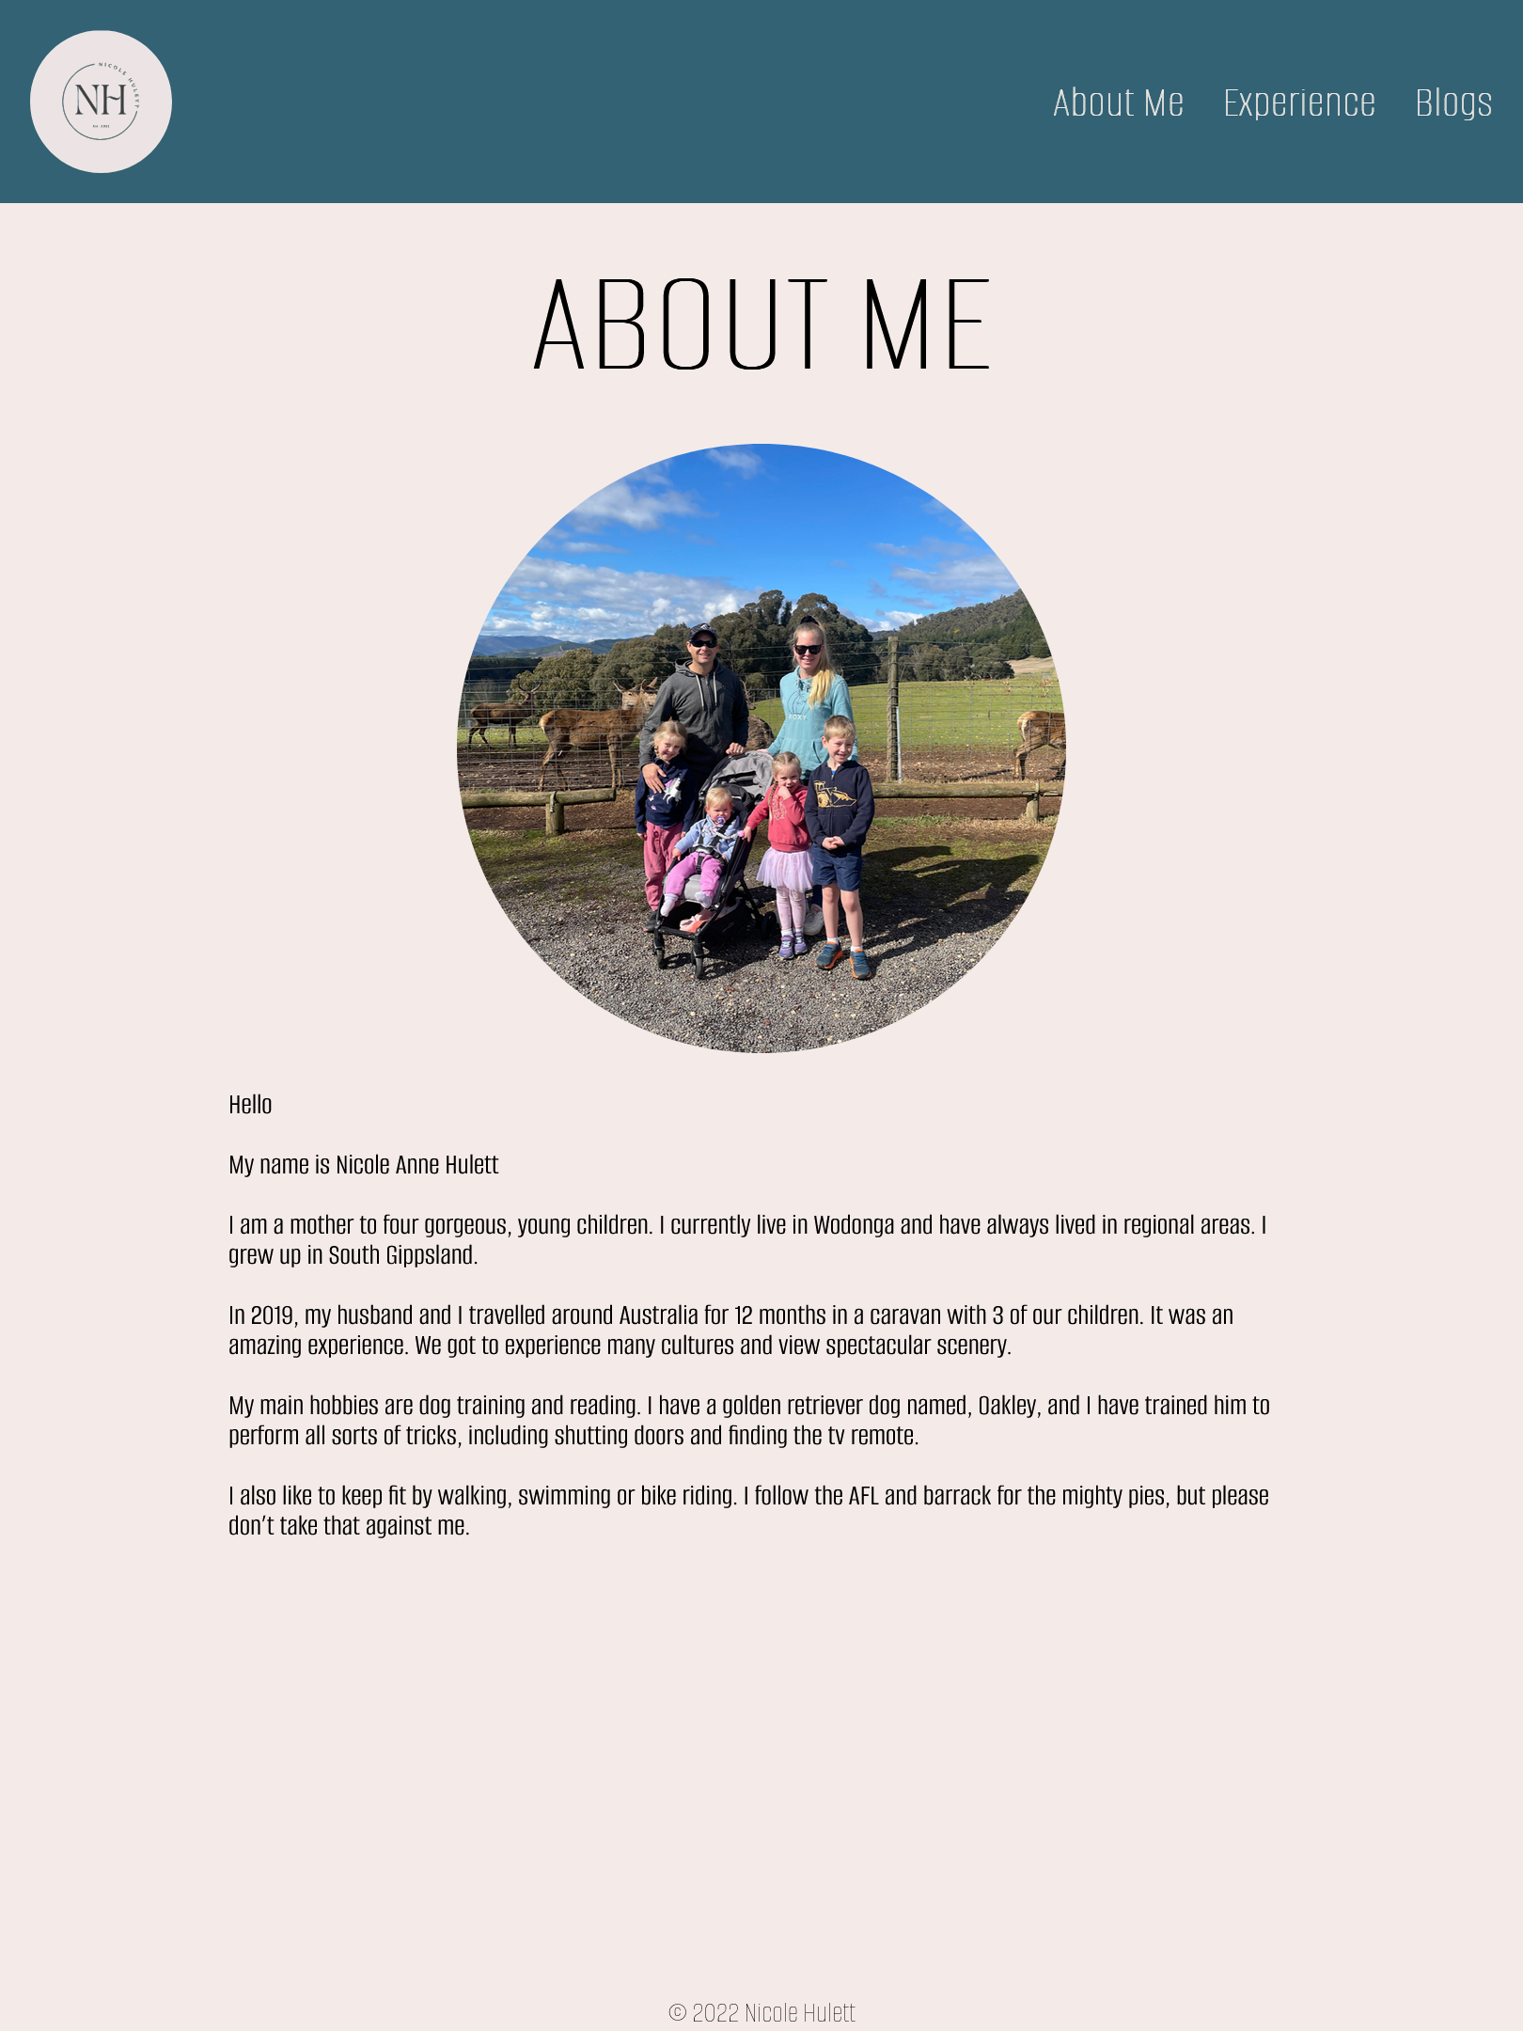
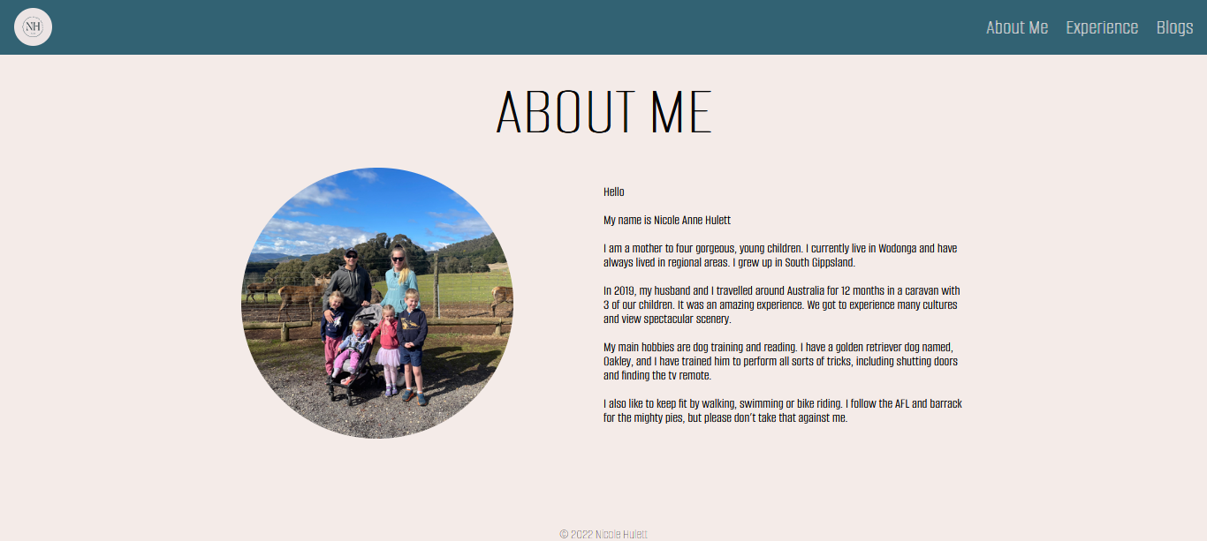
About Me
Mobile and tablet designs are the same, but sizes of containers and pic is vh, vw or % so everything is responsive.
Layout changes at 920px using a media query.
There is a container around pic and information.
Copyright symbol is located at the bottom of every page.
This was a challenge I had getting it to stay at bottom of page.

Slide 8
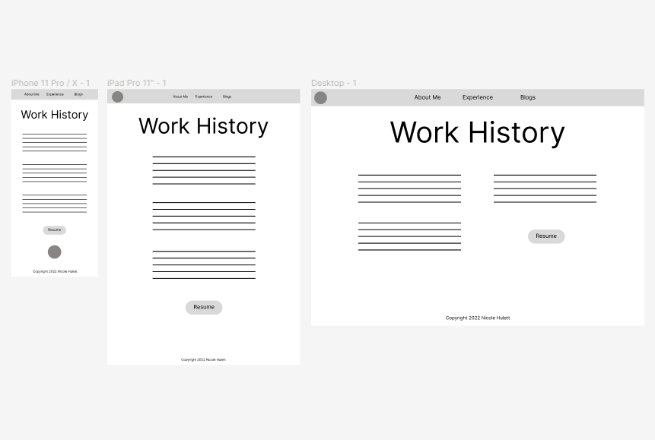
Wireframes for Experience page
A very basic design utilizing flex-box.
- Link to resume is underneath text and should open in a new page.

Slide 9
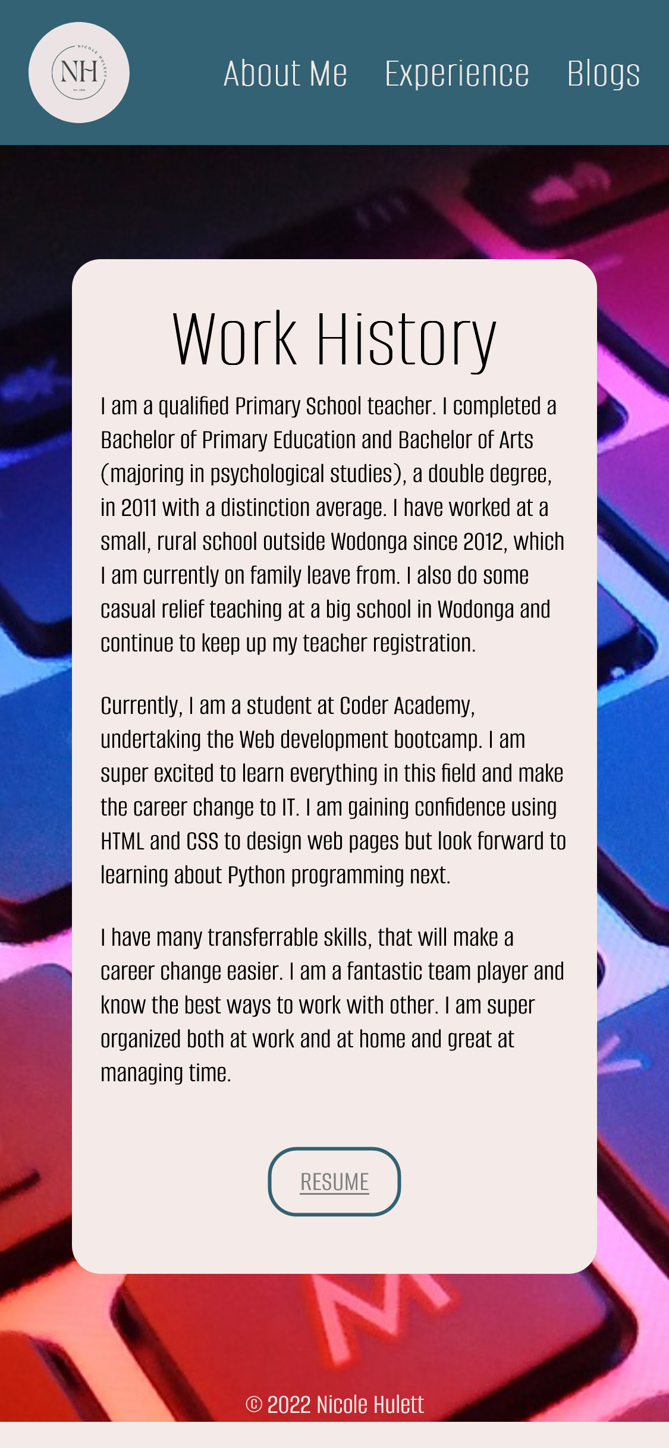
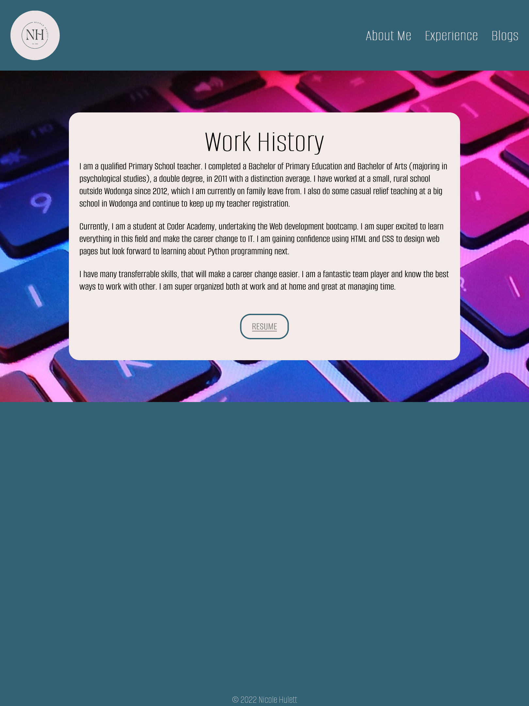
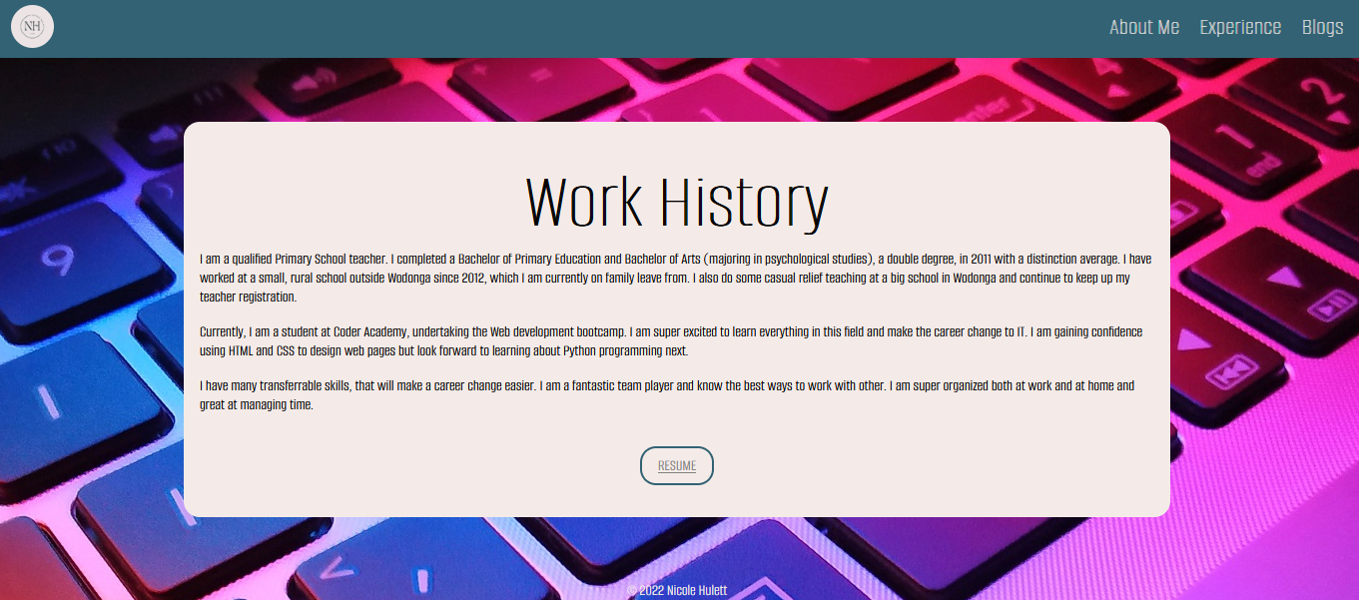
Experience
This is a very basic layout utilizing flexbox. The body container contains the child elements of header, main section and footer. These child elements also are flex containers themselves.
Added a background image
Resume link component
This link opens a new page to view a PDF version of my resume. Link is styled with rounded corners and has a hover function.

Slide 10
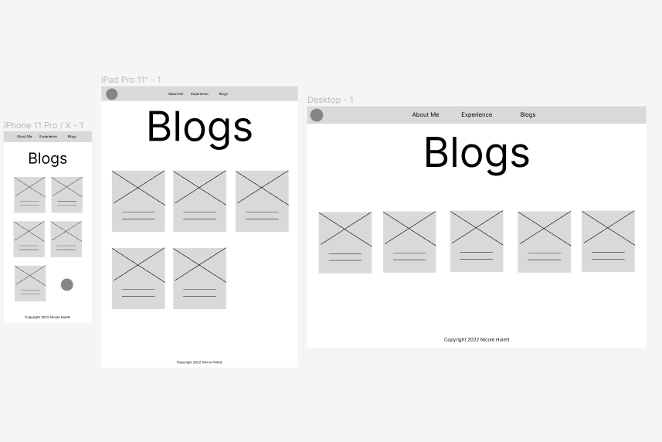
Wireframes for Blogs page
The header bar was changed to display the navigation links to the right of page top instead of centered. This allowed it to be responsive from mobile to desktop.
- The cards are within a container with a left and right margin.

Slide 11
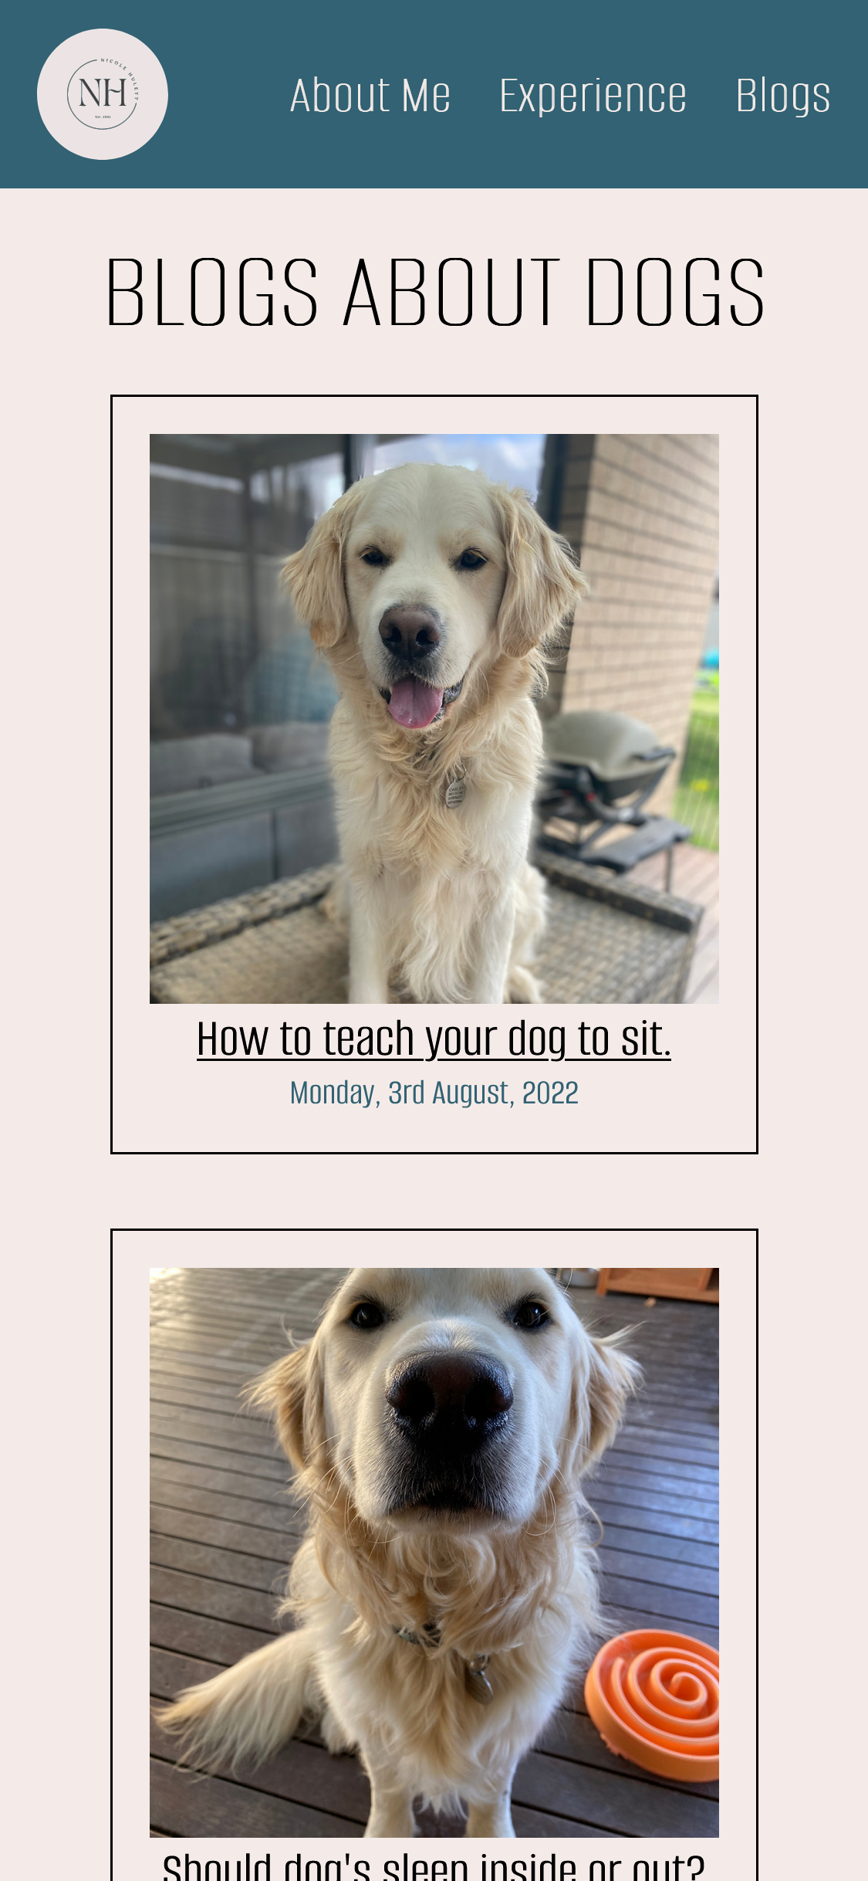
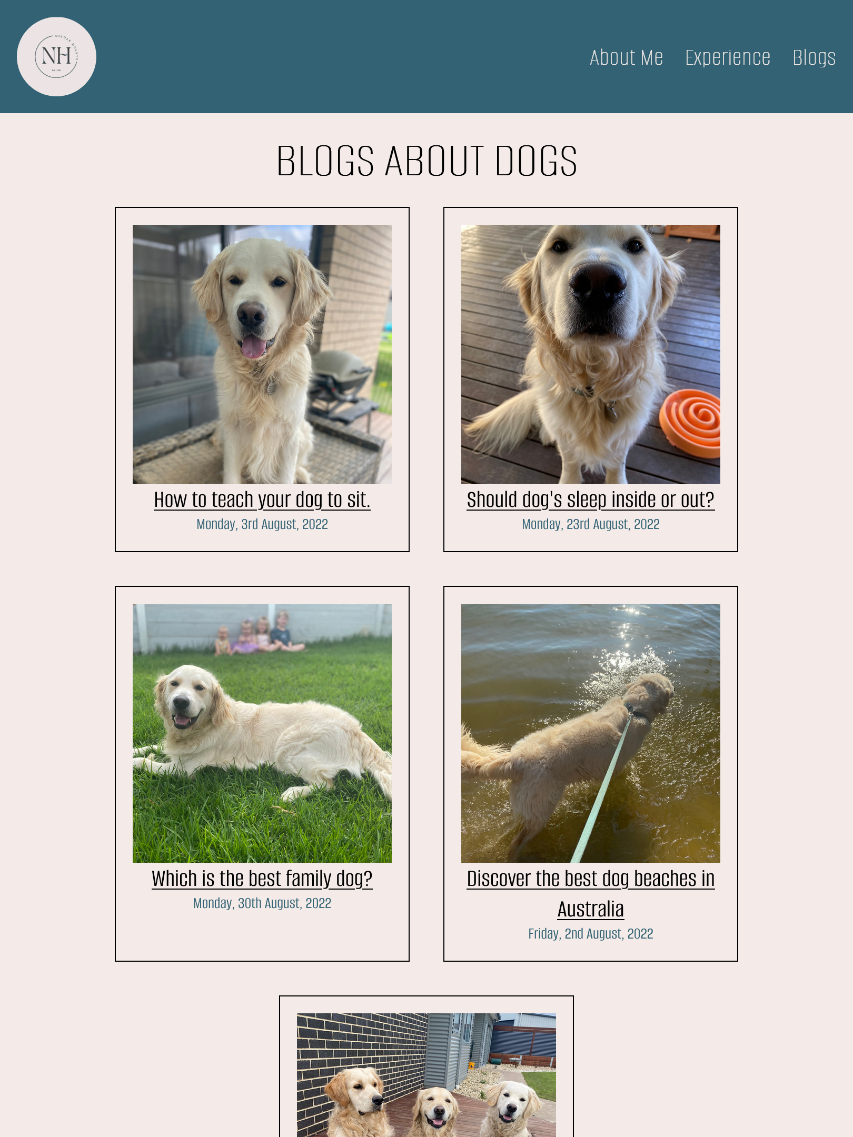
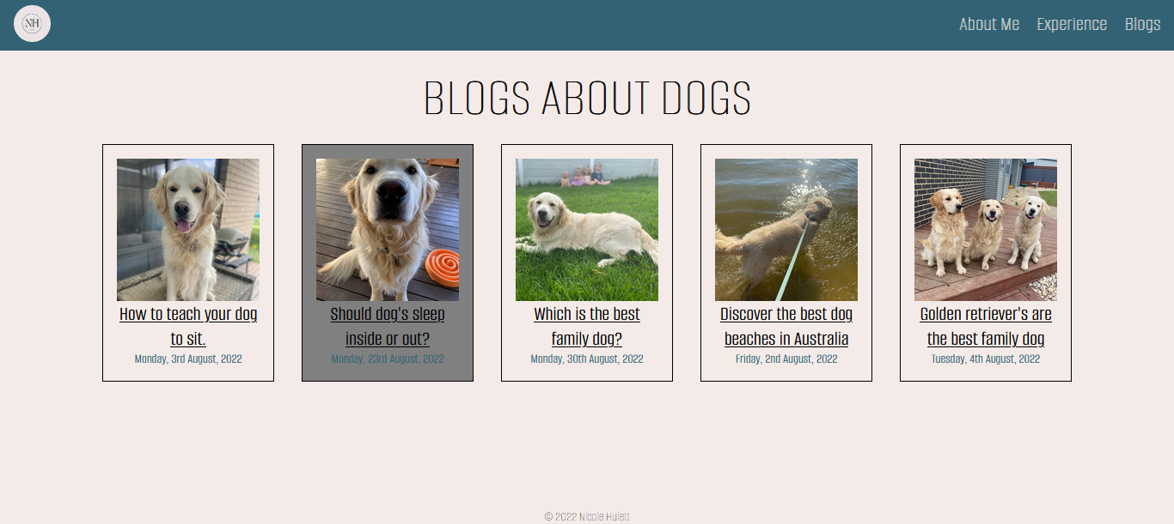
Flexbox is utilized on this page to layout the ‘blog cards’ all of which are in a container. I gave each card component a fixed max-width so that they all appeared the same size even with different screen sizes.
Blogs
A media query is added at 920px to slightly adjust the width of the ‘blog cards’ so that 5 of them can fit across the screen according to wireframes.
The title is also enlarged here.
Text and graphical component
The title of each blog is a link and goes to the blog post.
I have used the flex-wrap property on the page so that the cards wrap to the next line when there is no space left. This helps with the responsiveness across 3 device widths.
There is a grey background effect applied when a cursor hovers over a blog card.

Slide 12
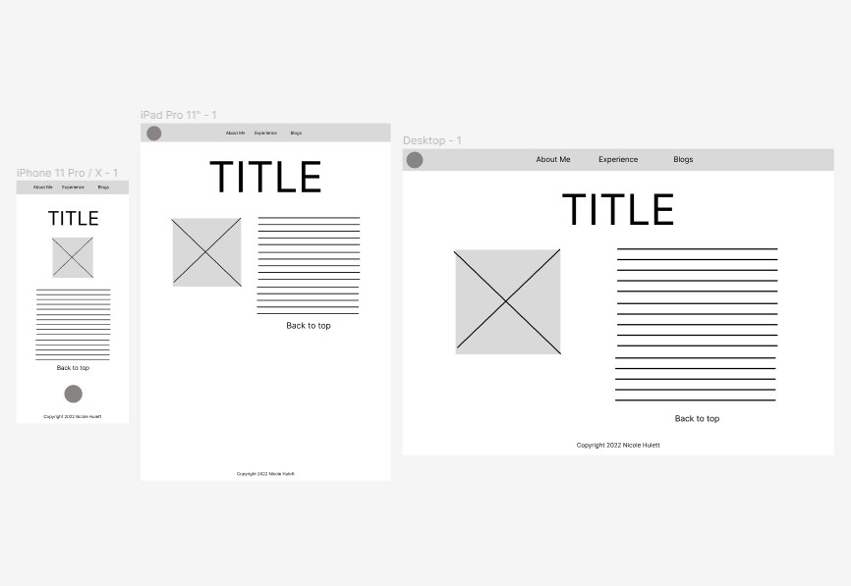
Wireframes for Blog Post page
This page is similar to the about me page.
The ‘back to top’ link wasn’t included in final design as the blog posts didn’t require scrolling.

Slide 13
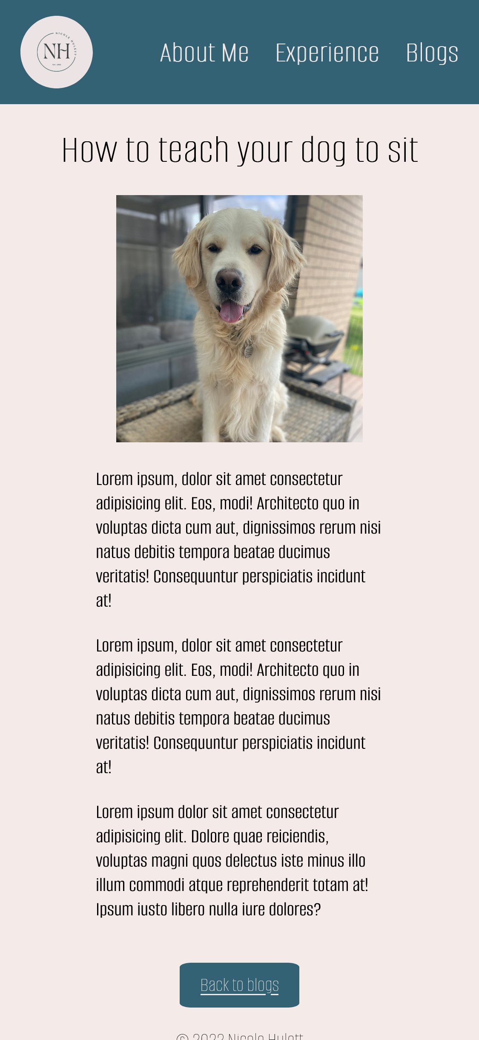
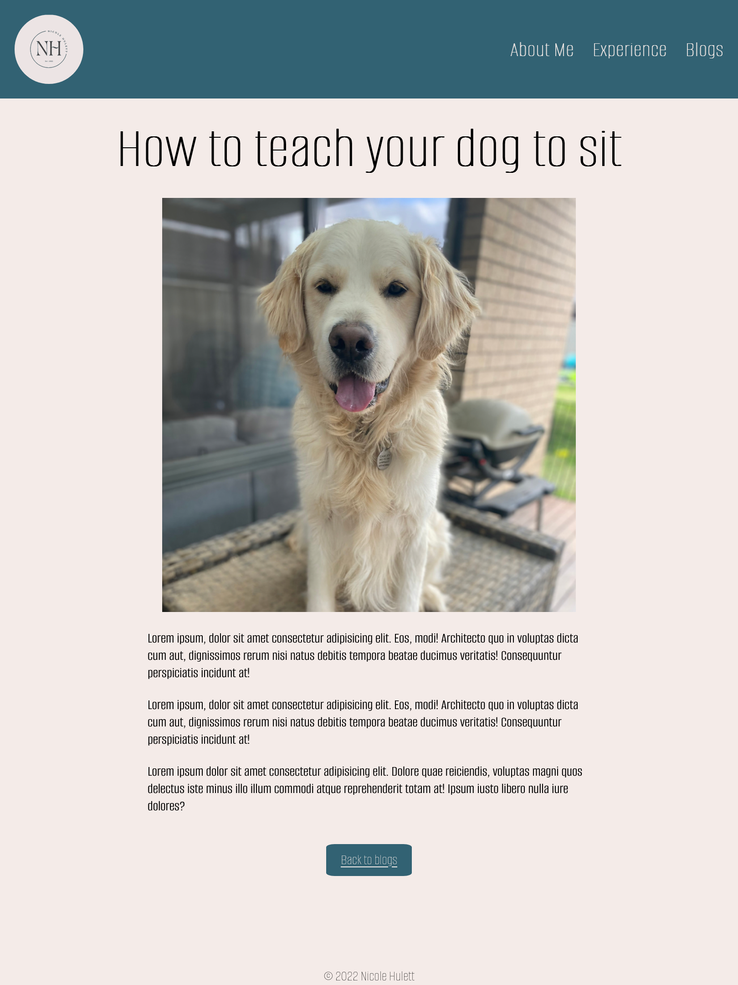
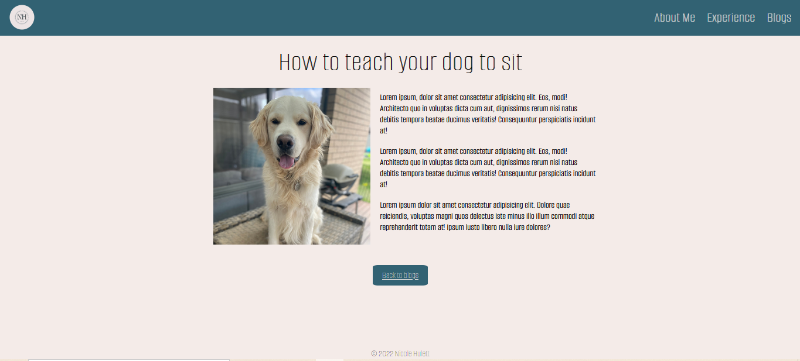
The logo in the header has a keyframes animation applied to it to make it appear to be pulsing when the page first loads. It scales up by 1 and down by 0.8.
Blog Page
In the desktop version, the flex-direction is changed at 920px to row. This allows for 2 columns as the container is around the pic and text.
The footer has a margin-bottom of 0 and margin-top of auto, to ensure that the text stays at the bottom of the page. This footer is also a flex item of the body container. The body container has a height of 100vh.
This is a very simple page layout that includes a link at bottom to return to the blogs page.
The link is styled and has a hover affect.

